Slide 1
Time History Analysis
General Requirements
  Time history analysis
    No fewer than three time history analyses
    Response parameters shall be calculated for each time history analysis, and the averaged value of each response parameter can be used for design
  Input ground motions
    Each input ground motion shall have magnitude, fault distance, and source mechanisms that are consistent with those that control the design earthquake
    Compatible with the design response spectrum

Slide 2
  Scale of the input ground motions
    Compatible with the design response spectrum
    The associated 5%-damped spectral response acceleration for each period between 0.2T and 1.5T (where T is the fundamental period of the building) does not fall below 90% of the value specified by the design response spectrum
    The averaged value during this period range shall be larger than or equal to the value averaged from the design response spectrum as specified by the code

Slide 3
Simulation of Spectrum Compatible Ground Motions
  Phase spectrum
    Phase characteristic of earthquake motion strongly controls the non-stationary nature of earthquake motions, the most important issue for simulating the input ground motion is to model the phase spectrum
    For an interesting site, the phase spectrum can be obtained from the earthquake ground motions observed at nearby observation stations while the selected earthquake being similar to the design earthquake in magnitude, fault distance, and source mechanisms

Slide 4


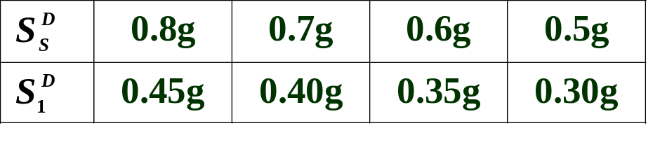
Design Spectrum
  Mapped design spectral response acceleration parameters
    Based on uniform hazard analysis (return period 475 yrs)
    5% damped spectral response acceleration at short periods ( )
    5% damped spectral response acceleration at 1 second ( )
    For each administration unit of village, town or city level
    Classification

Slide 5


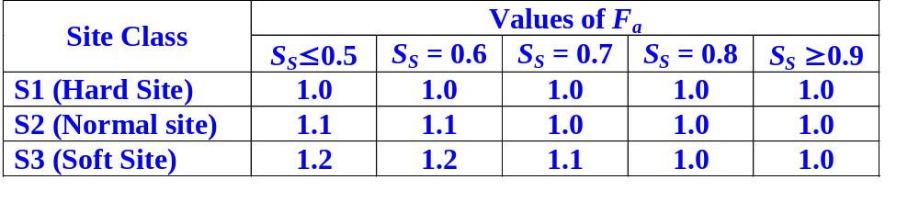

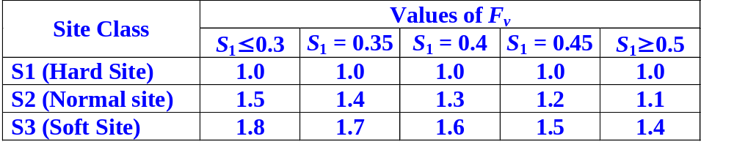
  Site adjusted spectral response acceleration parameters
    Include local site effects by site coefficients F_{a} and F_{v}
  Site coefficients
    Functions of site class and mapped spectral response acceleration parameters (Nonlinear effect)
    Values of F_{a} (dependent on )
    Values of F_{v} (dependent on )

Slide 6
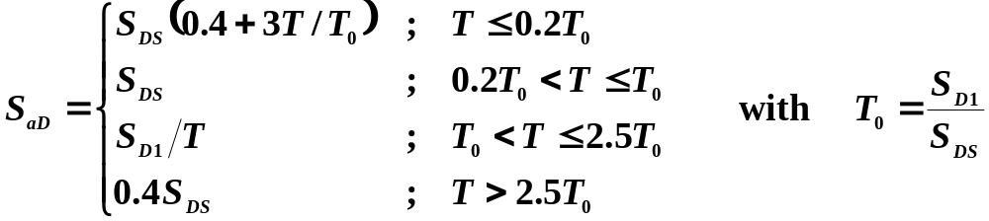
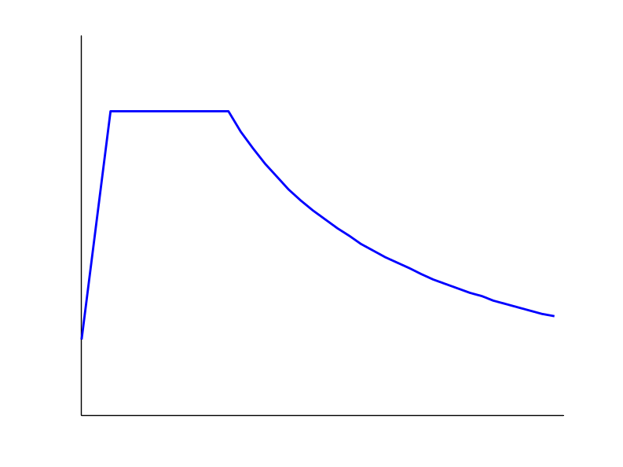
  Design spectral response acceleration
    Based on the site adjusted spectral response acceleration parameters S_{DS} and S_{D1}
    Design response spectrum curve
S_{DS}
T₀=S_{D1}/S_{DS}
Design spectrum S_{aD}
S_{D1}
S_{aD}=S_{D1}/T
0.4S_{DS}
EPA=0.4S_{DS}
0.4S_{DS}
0.2T₀
T₀
1.0
2.5T₀
Period (sec)

Slide 7
  Recursive procedures to simulation of spectrum compatible ground motions
Dominated by the wave with resonance frequency
MF_{n}(ω=2π/T)=S_{aD}(T)/S_{an}(T)
Φ (ω)
X_{n}(ω)
x_{n}(t)
S_{an}(T)
MF_{n}(ω)
x(t)
A_{n}(ω)
If MF_{n}≈1
for all ω
A_{n+1}(ω)=MF_{n}(ω)×A_{n}(ω)
n=n+1

